Slide 1
Image Processing Project1

Slide 2
Different Fields:
Image denoising : The purpose of image it is to remove unnecessary noise in the image , and to retain more important details in the image , so that the image appears clear and clean.
Image encryption : Nowadays , information security is becoming more important in data storage and transmission . Image encryption method prepared information unreadable . Therefore , no hacker or eavesdropper , including server administrators and others , have access to original message or any other type of transmitted information through public networks such as internet.
Image enhancing : It is the process of digitally manipulating a stored image using software.
Image recognition: A subset of computer vision , in that it refers to the ability of a computer to “see”, to decipher and understand the information fed to it from an image , be in a still , video, graphic, or even live.

Slide 3
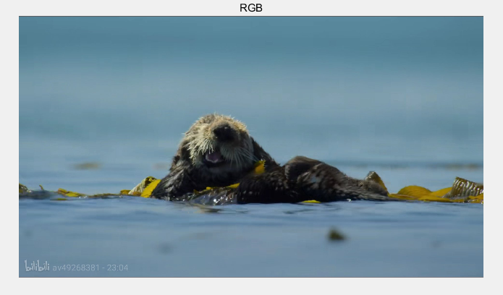
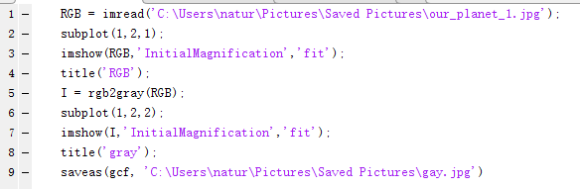
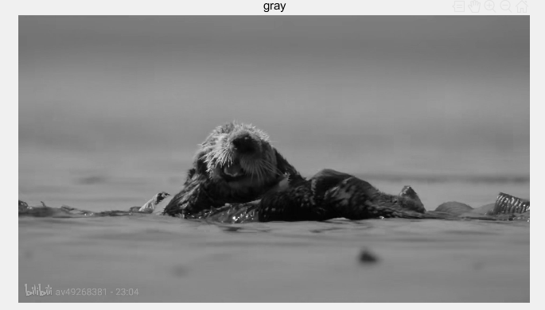
RGB2Gray

Slide 4
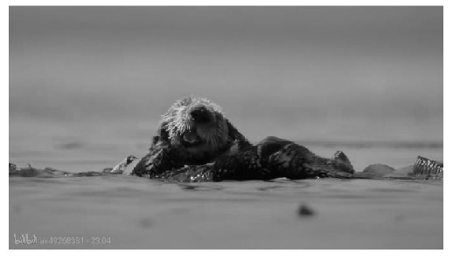
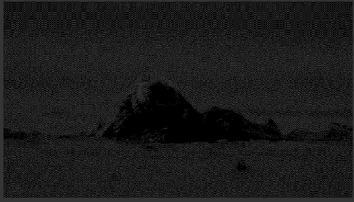
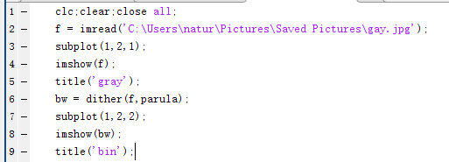
Gray2Bin

Slide 5
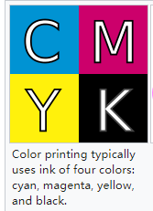
Color Model:https://en.wikipedia.org/wiki/Color_model#RGB_color_modell
RGB: It is an additive color model in which red, green and blue light are added together in various ways to reproduce a broad array of colors.
CMY: It is a subtractive color model, used in color printing, and is also used to describe the printing process itself. Four inks: cyan, magenta and yellow.
CMYK: In order to generate true black in the print, add a fourth color-key.
Cylindrical-coordinate color models:
HSI: hue, saturation, lightness
HSV: hue, saturation, value
Munsell color system: hue, value, chroma, lookup table
RGB is ideal for image color generation, but there are many limitations when
it comes to color description. The HIS model is a nature and intuitive description of color.

Slide 6
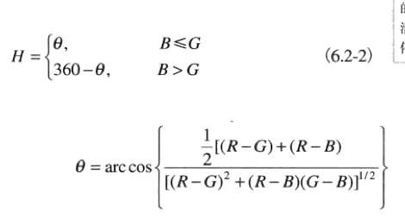

HIS and RGB
I = $\frac{R+G+B}{3}$
S = 1-$\frac{\min\left(R,G,B\right)}{I}$ (if I ≠ 0)

Slide 7
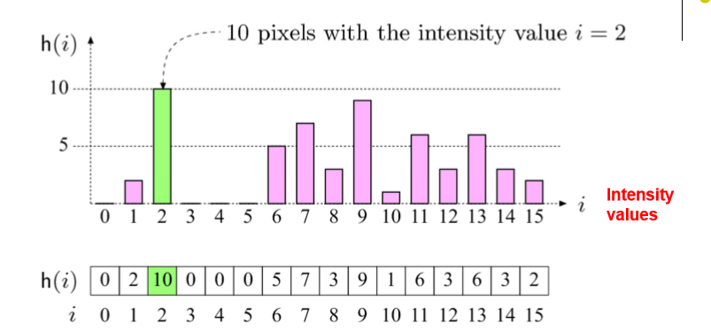
Image histogram: plots how many times(frequency) each intensity value in image occurs
No indication of location of pixels
It helps detect image acquisition issues

Slide 8
Difference:
Gray: intensity values in range [0,L-1], s=T(r) in range [0,L-1]
Good Contrast: Widely spread intensity values +large difference between min and max intensity values.

Slide 9
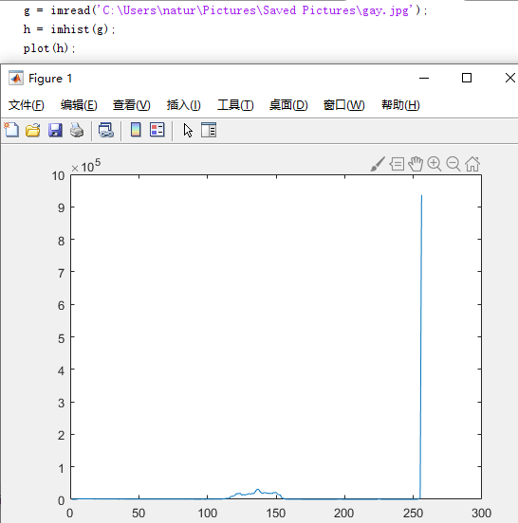
Difference:
Color image histograms:
Intensity histogram:
Convert color image to gray scale
Display histogram of gray scale

Slide 10
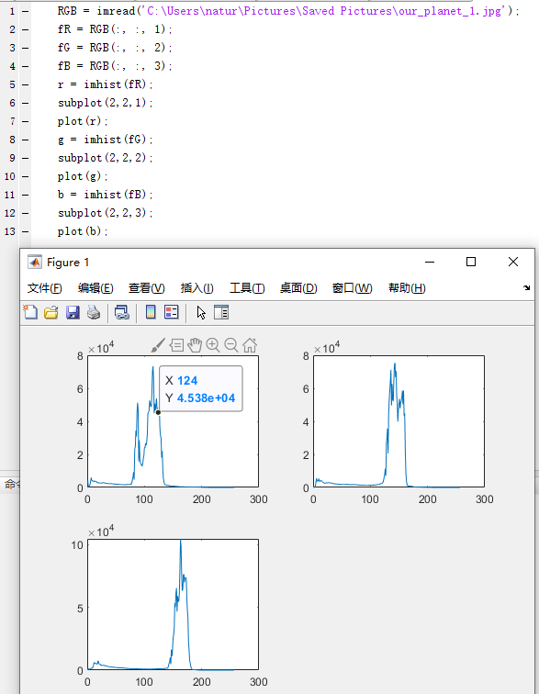
2. Individual color channel histograms
3 histograms(R,G,B)

Slide 11
Supervised learning
It is a learning in which we teach or train the machine using data which is well labeled that means some data is already tagged with the correct answer. After that, the machine is provided with a new set examples so that supervised learning algorithm analyses the training data and produces a correct outcome from labeled data.
Algorithms:
Classification: the output of the model is a categorical variable
Regression: the output of the model is a continuous numerical variable

Slide 12
Unsupervised learning
It is the training of machine using information that is neither classified nor labeled and allowing the algorithm to act on that information without guidance. Here the task of machine is to group unsorted information according to similarities, patterns and differences without any prior training of data.
Algorithms:
Clustering: is the task of grouping a set of objects in such a way that objects in the same group(called a cluster) are more similar(in some sense or another) to each other than to those in other groups(clusters).(Inherent grouping)弱关系
Association: is a method for discovering interesting relations between variables in large databases. (Law)强关系

